Slide 1
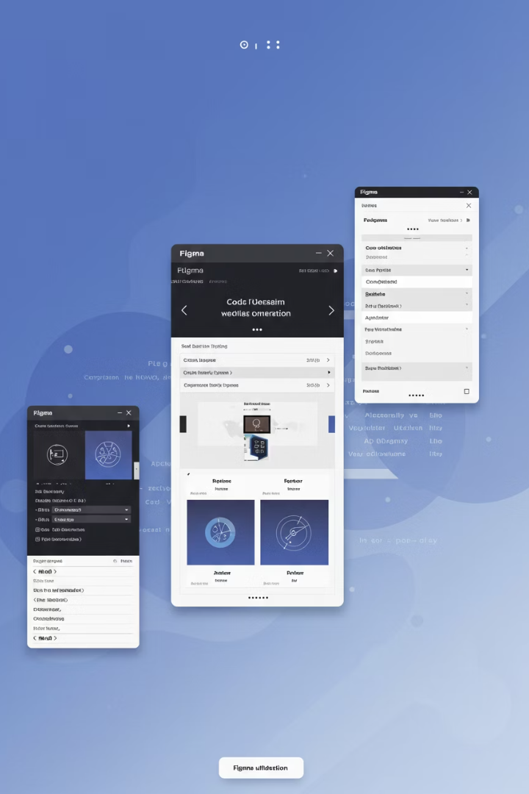
UI Spark: AI-Powered UI Development
Transform your UI designs into production-ready Angular code with UI Spark. Our AI-powered tool combines GPT-4 vision with Figma integration for seamless development.
AS
by Advik Sarang

Slide 2
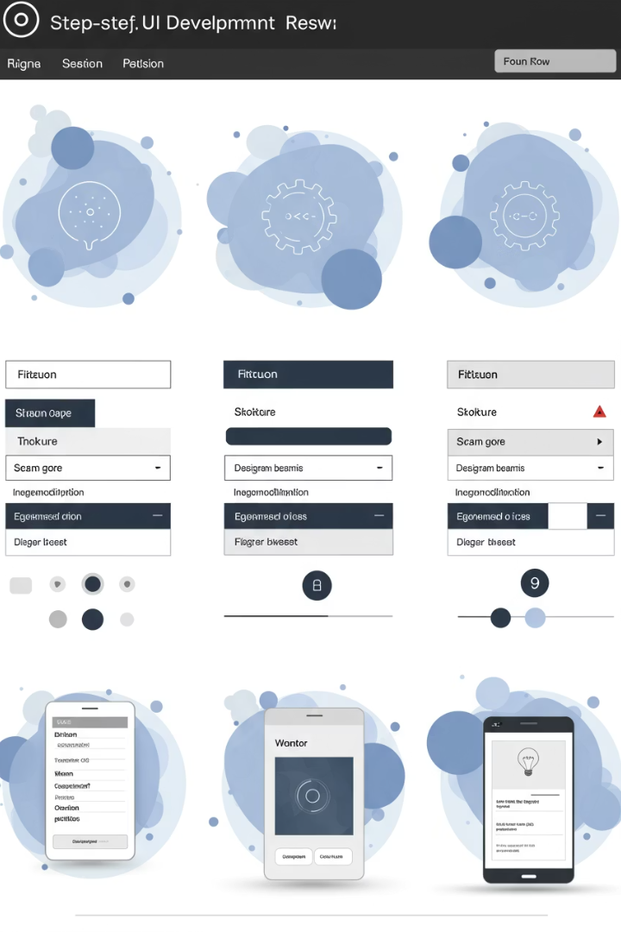



How UI Spark Works
Analyze Design
AI vision processes PNG/JPG files to create UI descriptions and user stories.
Load Figma
Extract exact measurements and components via Figma URL integration.
Generate Code
Combine all inputs to produce Angular components with TS, HTML, and SCSS.

Slide 3

Technology Stack
Frontend
AI/ML
Integrations & Output
Streamlit (Python)
GPT-4 with vision
LangChain Figma Loader
Real-time preview
Custom prompt engineering
Angular 16+, TypeScript, SCSS

